Slide 1

Notes:
I am a Nursing administrator with ODP and currently serve as the lead for State Health Initiatives. I’ve been with ODP for 13 years. I spent 11 of those at Polk Center in various roles such as staff RN, RNS, Nurse Manager and Director of Clinical Services. Prior to that I worked as an RN in long-term care and hospice.

Slide 2

Notes:
Planning for STAT began before I started in my current role but based on my experience in the years at Polk Center, I understand why a service like were going to talk about today is so very important.
Transition into many people with IDA contributing reasons and 4 points on slide.

Slide 3
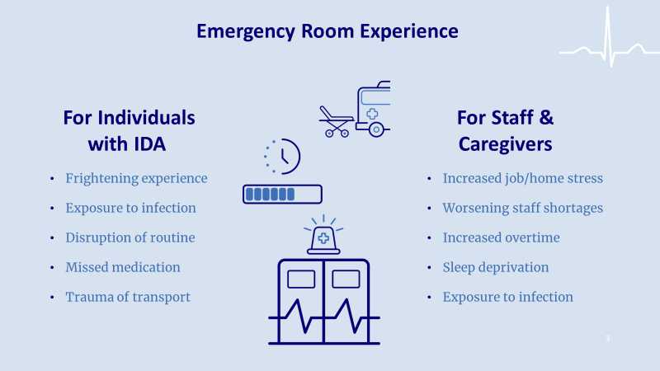
Notes:
While it is very important to get care at the ER when needed and when necessary to go, however we know that individuals with IDA going to the ER can be more complicated. Not only the individuals themselves but family members and caregivers.

Slide 4
Specialty Telehealth and Assessment Team (STAT):
This service is consultative and provides disability-specific advice on when best to seek additional or in-person medical treatment for the participant.
Can occur in the participant’s private or residential home to help assess their need for medical attention
Includes support and consultation to paid and unpaid caregivers to build their capacity to better understand the best approaches for supporting the participant depending on their symptom presentation.
Notes:
So what stat is, is a 24/7 telehealth service that provides what we call right on time health assessments. This service is consultative and provides disability specific advice. Of when to best seek additional or in person medical treatment for the participants. So, this is a service that can occur in the participants of private home or residential home to help assess their need for medical attention and as part of this it would include the availability of support and consultation to both paid and unpaid caregivers to build their capacity to better understand the best approaches for supporting the individual depending on their symptom, presentation.

Slide 5
STAT
This service will not duplicate any service available to the participant through the state plan.
This service will not supplant in-person exams as needed.
This service is provided as a monthly service and billed in monthly units.
Notes:
It's written into the service definition that this is not intended to duplicate any service that is available through the state plan, and very importantly, this service is not intended to replace in person exams. The goal is not to prevent people from going to the emergency room or seeing a physician in person when needed. It is a support that can help to alleviate the burden of all those things that we discussed when it isn't absolutely necessary for the individual to be seen in person. This is a service that will be provided as a monthly service and billed in monthly units. One unit equals one month at 55 dollars a unit.

Slide 6
STAT
All individuals enrolled in Person Family Directed Support (P/FDS), Community Living and Consolidated waiver are eligible for the service (all ages and living situations).
STAT must be added to the ISP and authorized by the Administrative Entity (AE) prior to the service being used.
STAT costs will be included in the annual limit for P/FDS and Community Living Waivers.
Notes:
So, all individuals that are involved in an IDA waiver, so Person Family Directed support, the community living and the consolidated waivers are eligible for this service. Available for all ages and all living situations as long as they are Enrolled in one of the IDA waivers. In order to access this service, stat must be added to the ISP and via a critical revision or at the time of the annual ISP and must be authorized by the administrative entity prior to the service being used. Stat costs will be included in the annual limit for PFTS and Community Living waiver. That's a question that's come up a bit is, is this cost that would live outside of the waiver limits, and it is not, it will be included in the annual limits, so guidance for enrolling individuals in stat has already been sent to the SCO and the administrative entities.

Slide 7
STAT
Physicians providing this service must have access to and be familiar with clinical guidelines for the provision of health care to individuals with intellectual and developmental disabilities.
Clinical guidelines must be based on evidence-based practices and clinical expertise and serve to inform the health care decisions and recommendations
All staff who will render this service must have completed specialized training/curriculum on how to provide medical assessment, treatment interventions, and recommendations regarding the physical health care needs of individuals with intellectual disabilities, developmental disabilities or autism.
Notes:
You know just a few more things about stat service that make it unique and and why it is. A service that we think will be really beneficial. odp made very high standards for providers to become qualified to provide this service, you know is the goal is truly a specialized care specialized. So that physicians should provide this service, must have access to and be familiar with clinical guidelines for the provision of health care to individuals with intellectual and developmental disabilities. But this isn't just that, it's something that anybody telehealth service that anybody can provide really requires expertise. Now these clinical guidelines must be based on evidence based practices and clinical expertise both and and serve to inform the healthcare decisions and recommendations. All staff who will render the service must have completed a specialized training curriculum on how to provide medical assessment on treatment interventions. And recommendations regarding the statistical healthcare needs of individuals with intellectual disabilities, developmental disabilities, or autism.

Slide 8
STAT
This service must be provided or overseen by physicians who are:
  Licensed to practice medicine in the Commonwealth of Pennsylvania, or have appropriate reciprocity
  Board Certified or board eligible with the American Board of Medical Specialties (ABMS)
Functions which are overseen by a physician with the above qualifications will be provided by a Registered Nurse, Certified Registered Nurse Practitioner, or Physician’s Assistant acting within their scope of practice
Notes:
And then finally, this service must be provided, overseen by physicians who are licensed to practice medicine in the Commonwealth of Pennsylvania or have an appropriate reciprocity, meaning that they're permitted to serve and then they must be board certified or board. Eligible with the American Board of Medical Specialties now any functions which will be overseen by the physician who meets those above qualifications. Umm. Must be provided by a registered Nurse, a certified registered nurse practitioner or physicians assistant. Got all, of course, acting within the scope of their practice. Station MD became a qualified provider for the stat service a little bit earlier this month, which means that they met the rigorous expectations of the state in order to. provide the support

Slide 9
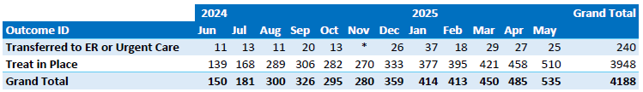
STAT
Calls by month and treat in place

Slide 10
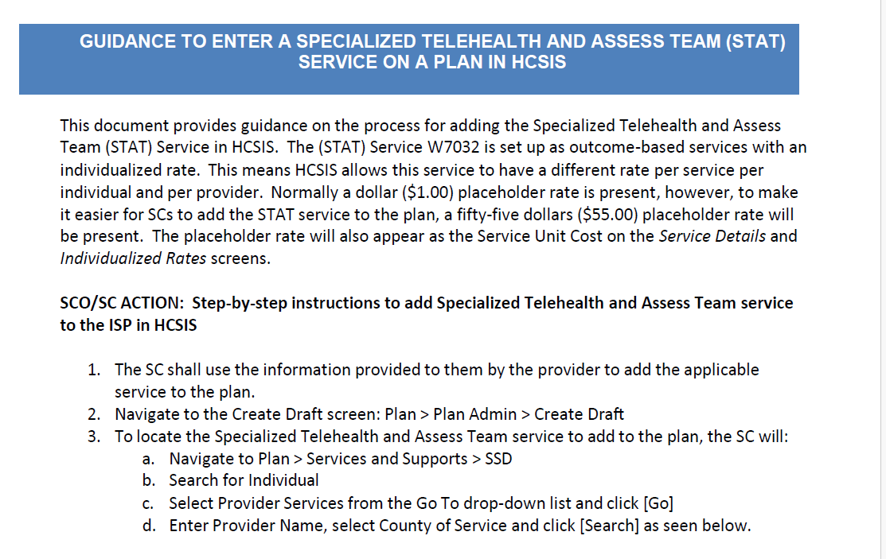
STAT

Slide 11
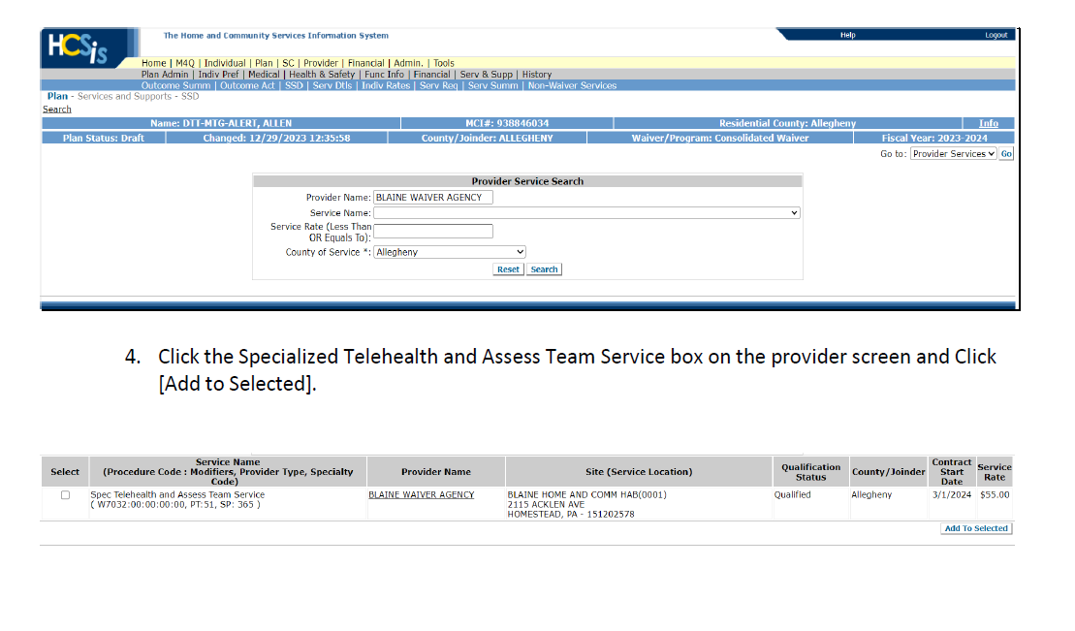
STAT

Slide 12
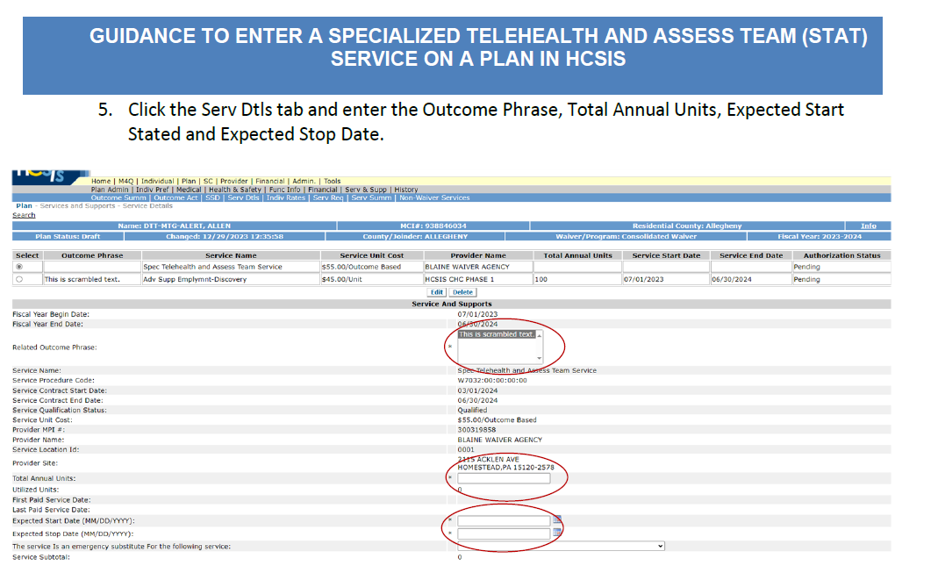
STAT

Slide 13
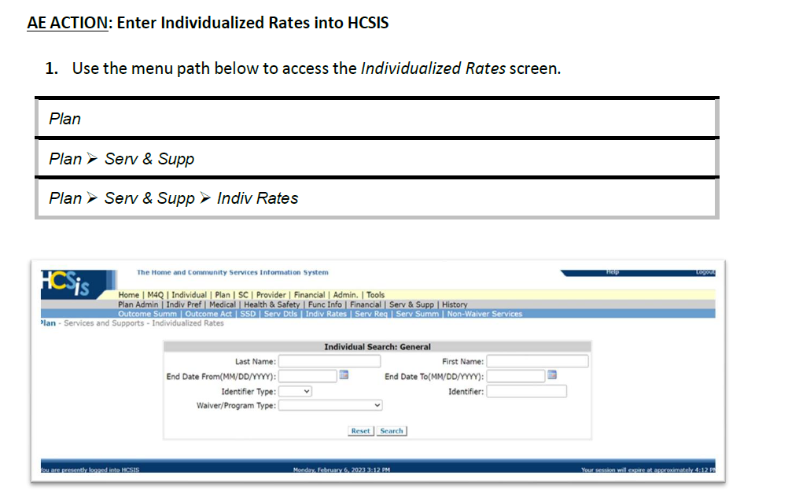
STAT

Slide 14
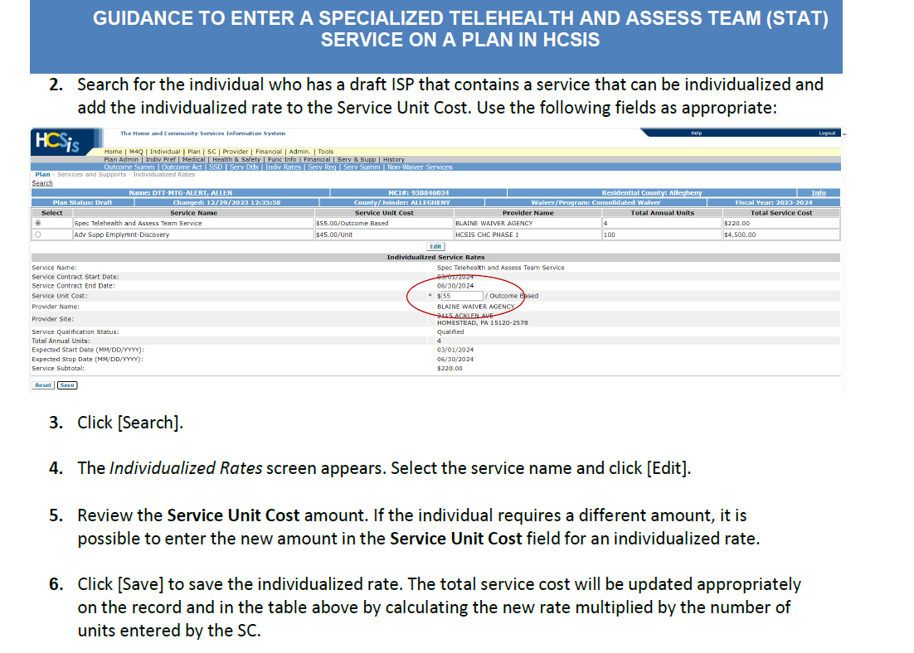
STAT

Slide 15
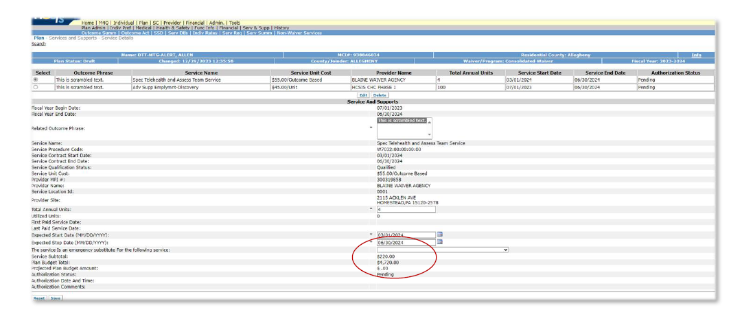
STAT

Slide 16

Comprehensive medical services & support to partnering I/DD organizations with 24/7/365 Telemedicine services via an ODP- approved STAT waiver program in Pennsylvania
Contact:
Tim Ortiz hello@Senacare.com 609-455-1576
Philadelphia, PA | Mickleton, NJ

Slide 17





SENA Overview
Technology for enhanced logistics & coordination
We build our own customized technology, incorporating Artificial Intelligence, to create an industry leading productive and supported care coordination staff
24/7/365 Care Coordination Command Center
We help people access in- home services at ANY time, at a low cost, with speed to market, leveraging tech
Hospital-Level Services in the Home
We bring up to 23 services into patient homes from our network of community providers
Expertise & support of a
medical practice
Senacare is a medical practice in PA & NJ. SENA Health partners with Senacare to innovate and iterate on the healing at home delivery care model. The learnings are then expanded to other markers
CONFIDENTIAL INFORMATION

Slide 18

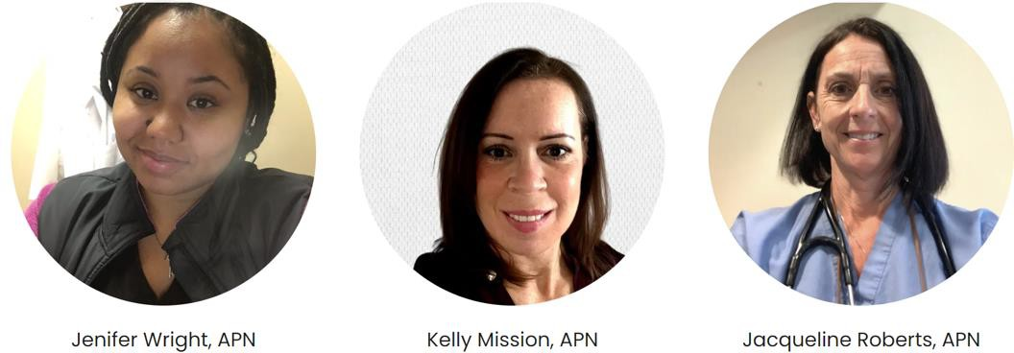

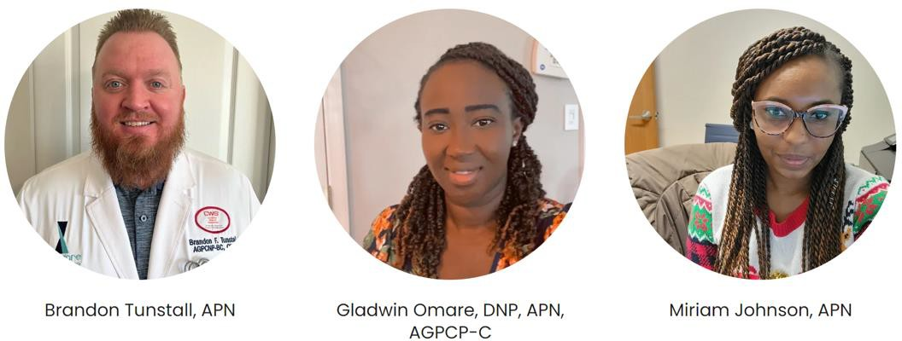
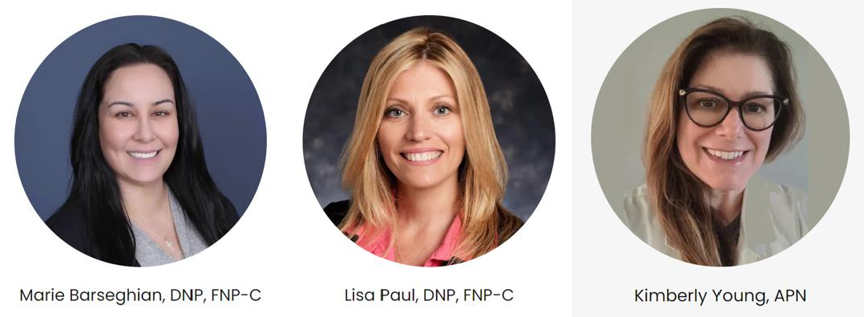
Senacare Medical Practice
22 providers with local healthcare knowledge specializing in complex care on-site / credentialed with all payers and on medical staff at local health systems
14 clinical nursing staff
Renada Woodyard, APN
Experience & training to care for the IDD
population
Patient support from Health
Coordinators working 24/7/365
CONFIDENTIAL INFORMATION

Slide 19
Senacare Medical Practice
Focus on access and communication
Technology: Remote Patient Monitoring
Ancillary services:
  Infusion services
  Wound care
  Hospital at Home
Community partnerships:
  Laboratory services
  Imaging
  Phlebotomy
  Hospital and specialty physicians partnerships
Specialties: Internal Medicine, Family medicine, pediatrics, infectious disease, psychiatry, wound care, PM&R, virtual care
Renada Woodyard, APN
CONFIDENTIAL INFORMATION

Slide 20



Case Study: Comprehensive Primary Care
Senacare’s Service Options
Onsite In-person primary care
Medical Director oversight
Virtual Telemedicine Care 24/7/365
Preventative Care
Pro-active care
Un-fragmented care
Familiar Care
24/7/365 Access
Team based approach
Care coordination
Results
Improved experience for all
Transition of care that’s coordinated 24/7/365 via Health Advocates
Reduced ER visits & Utilization
Engaged Team members
Specialists
Ancillary services
Financial Success
Data and Metrics

Slide 21
Flexible services based on needs 24/7/365 access via our clinical command center:
Physician Advisory Services:
  Strategy: medical policies, utilization management, payers, community partners, etc
  gaps in care closure: ordering preventative screening, labs, etc
  Support: complex care, hospitalizations, clinical staff support, etc
  Hospital admission support and advocacy
  Physician to physician clinical communication and support
  Access to medical records and local Health Information exchanges
Onsite provider services (professional services arrangement)
Proactive Telemedicine (24/7/365 virtual care)

Slide 22
Flexible services based on needs 24/7/365 access (cont.) :
At home on-site services: imaging, phlebotomy, etc (where available)
Nursing support, guidance, and training
Administrative support
Policy review and support
Strategy support for clinical integration
Advocacy and second opinions
Relationships with local health systems and physicians (on medical staff)
Medical specialties: Primary Care, Psychiatry, Pediatrics, Infectious Disease, wound care, Internal Medicine, Family Medicine, and more

Slide 23
Telemedicine services 24/7/365
ODP approved provider of the STAT waiver service in Pennsylvania
Access to our doctors and nurse practitioners for medical conditions such as:
  Assessment to determine the urgency of conditions (i.e. ER vs urgent care)
  Rash, fever, cough, pain, pink eye, diarrhea, urine infections, falls, seizures, injuries, and various seasonal illnesses
  Gaps in care, prescription refills, general guidance for medical conditions, etc
Enrolling on the ISP:
  Senacare is a “Specialty Telehealth & Assessment Team (STAT)” service available to PA residents on the consolidated waiver, community living waiver, and PA person/family Directed support waiver.
  Supports Coordinators help individuals/families/guardians to elect Senacare’s
service on the ISP using the W7032 procedure code

Slide 24
Telemedicine services 24/7/365
ODP approved provider of the STAT waiver service in Pennsylvania
Service can be added at any point during the year
1 unit of procedure code W7032 is $55 a month for 24/7/365 unlimited contact with Senacare telemedicine services
Individuals can start using the service immediately after enrollment by calling our 24/7/365 clinical command center
Monthly outcomes report and data analytics

Slide 25










Some of our trusted partners

Slide 26
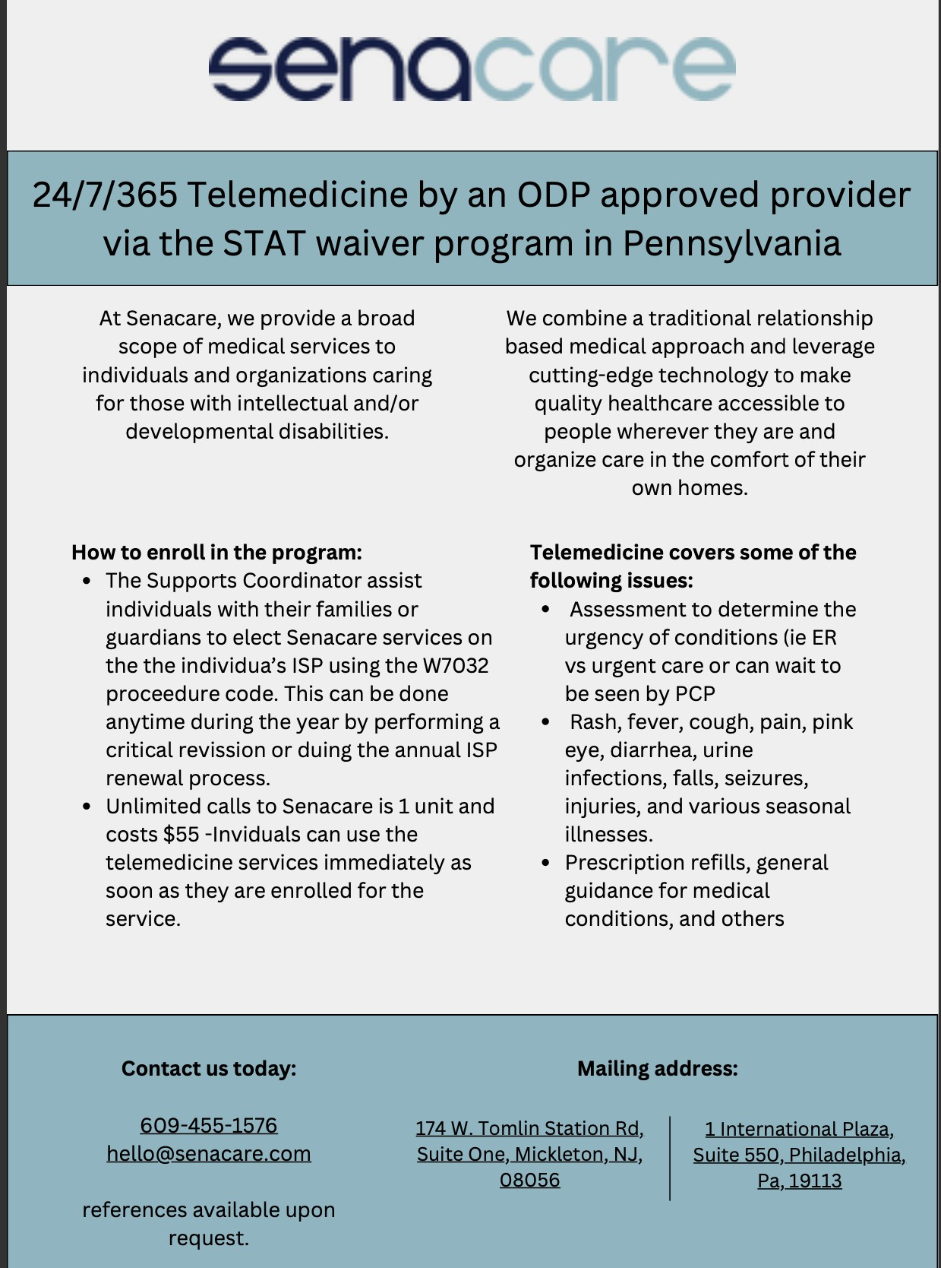

Slide 27
Contact us
References available from partnering organizations
Flexibility in our partnership agreements i.e. Telemedicine only
Partnership that focuses on outcomes that matter
Flexible financial arrangements to meet your program’s needs
Strategizing with payers for value-based care at scale
Contact:
Dr Anthony Wehbe or Tim Ortiz hello@Senacare.com
609-455-1576

Slide 28
STAT
Questions?

