Slide 1
Summary of Changes to the Provider Qualification Documentation Record (PQDR)
Notes:
Significant changes were made to the IDA Documentation Requirements Tab 5 and minor changes to the following: Tab 1. Instructions, Tab 2. Agency Demographics, Tab 14. Electronic Fingerprinting, and Tab 15. Q&A.

Slide 2
Tab 1 Instructions & Tab 2 Agency Demographics
Minor Changes
Notes:
Starting with some of the minor changes…

Slide 3



Tab 1. Instructions
Notes:
There were very minor changes to the Instructions Tab. We removed the language related to prospective providers for the Residential Readiness Tool. In addition, for each heading, we included links to the actual Tabs. For instance, when you click on the Agency Owned Automobile Qualification Tab header, it will take you directly to Tab 3. Likewise, once you are on this Tab, you can click on the Instructions, and it will take you back to Tab 1 instructions for Agency Owned Automobile Qualifications.

Slide 4
Tab 2. Agency Demographics
NEW RESIDENTIAL PROVIDERS AND EXISTING PROVIDERS ENROLLING FOR RESIDENTIAL HABILITATION, LIFE SHARING, AND SUPPORTED LIVING FOR THE FIRST TIME
Effective November 01, 2021, prospective providers or Existing providers that are interested in adding residential services as a specialty in the Consolidated, Community Living, and Adult Autism Waivers must complete the Residential Readiness Tool. This tool is to be completed by the provider prior to being qualified to render Residential Habilitation, Life Sharing, and/or Supported Living Services. The provider will receive an email with the date the AE determined the provider was “Ready to Provide Residential Services” on the Residential Readiness Tool. Providers cannot be qualified for residential services without completing the Residential Readiness Tool and receiving the confirmation email from the AE that the provider is “Ready to Provide Residential Services.
NEW RESIDENTIAL PROVIDERS AND EXISTING PROVIDERS ENROLLING FOR RESIDENTIAL HABILITATION, LIFE SHARING, AND SUPPORTED LIVING FOR THE FIRST TIME
TRAINING REQUIREMENTS |  |  | DATE
ISP Residential Staffing Webinar Certificate Date (include copy of certificate with supporting documentation). CEO must complete this training.
Health Risk Screening Tool (HRST) Webinar Certificate Date (include copy of certificate with supporting documentation). CEO must complete this training.
ODP Approved Dual Diagnosis Training Curriculum Certificate Date (include copy of certificate with supporting documentation). CEO must complete this training. |  |  | Friday, January 1, 2100
Notes:
Due to new qualification requirements that providers must have actively provided direct non-residential HCBS as a provider enrolled to provide ODP Waiver services for the two years prior to enrolling to provide Residential Habilitation, Life Sharing, or Supported Living and be in good standing (not subject to sanctions or enforcement actions by the Department), the Agency Demographics Tab has been updated to remove language regarding new residential providers.

Slide 5
Tab 5. IDA Doc Requirements

Slide 6
Remote Support
SERVICE NAME | PROCEDURE CODE | PROVIDER TYPE | SPECIALTY | Service Location Requirements
Remote Support -Service | W6088 | 51. Home & Community Habilitation | 364. Remote Supports | Have a secure, central facility in the United States
Remote Support Technology/Equipment | W6087 | 51. Home & Community Habilitation | 364. Remote Supports | Have a secure, central facility in the United States
Notes:
At the top of Tab 5 under Remote Support, under the far-right column titled Service Location Requirements, Remote Support was changed to indicate that providers must have a secure central facility in the US. ODP proposed changes to qualification requirements for agencies that render Remote Supports in private homes and community settings to reflect the expectation that staff be available for in-person training instead of requiring a service location in Pennsylvania or a state contiguous to Pennsylvania.

Slide 7
Shift Nursing
SERVICE NAME | PROCEDURE CODE | PROVIDER TYPE | SPECIALTY | Criminal Clearances for Direct Support Staff | PA Code License | Education, Experience, Training, etc.
Shift Nursing | T2025 | 05. Home Health | 051. Private Duty Nursing | Copies of clearances | 28 Pa. Code, Part IV, Health Facilities Subpart F. Chapter 601 and Subpart A. Chapter 51 | The provider should supply a copy of the current home health license to the AE.
Notes:
At the top of Tab 5, under Shift Nursing, for Private Duty Nursing, we removed reference to 49 Pa Code Chapter 21 as this is not a license. The provider should just supply a home health license to the AE. This license is under the following: 28 Pa. Code, Part IV, Health Facilities Subpart F. Chapter 601 and Subpart A. Chapter 51.

Slide 8
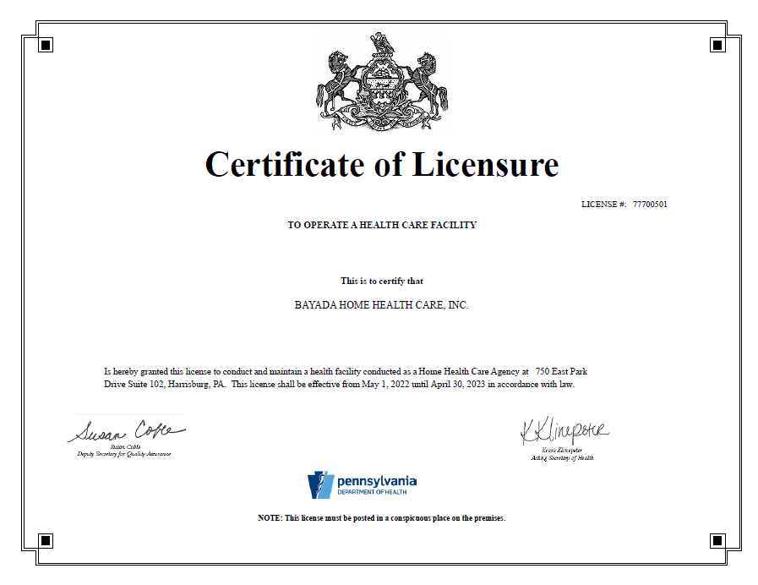
Notes:
The following is an example of the license.

Slide 9
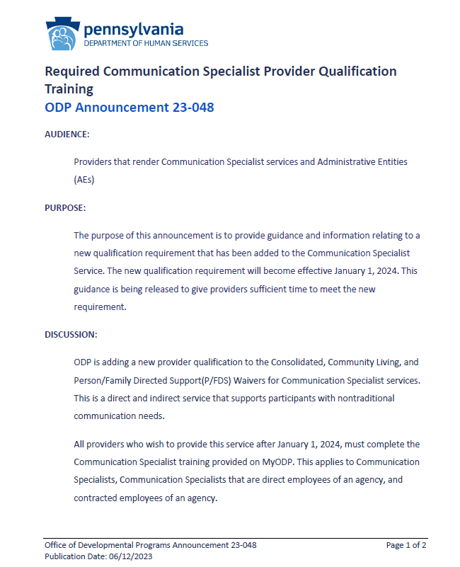
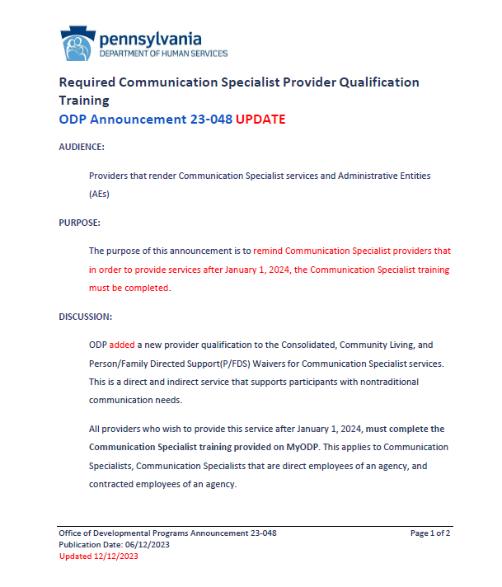
Required Communication Specialist Provider Qualification Training
Notes:
On June 12, 2023, ODP released communication, ODPANN 23-048: Required Communication Specialist Provider Qualification Training. The announcement provides guidance and information relating to a new qualification requirement that has been added to the Communication Specialist Service. The new qualification requirement will become effective January 1, 2024. This guidance was released in June to give providers sufficient time to meet the new requirement. An update reminder of this communication was also sent on December 11, 2023.

Slide 10
Communication Specialist
COMMUNICATION SPECIALIST | VALIDATION DOCUMENTATION
Experience in Speech Language Pathology, OR ● sign linguistics, OR ● Education of deaf, OR ● another relevant professional background AND ● Have personal or professional experience with people with ID/autism. Clarification: For Residential Services, Communication Specialist requirements are part of the residential rate. However, Providers need a modifier in order to do this and in order to get the modifier Providers must have a qualified person. As a result, Providers should have a plan in place that shows they will have a Communication Specialist when they need one. All providers who wish to provide this service must complete the Communication Specialist training provided on MyODP. This applies to Communication Specialists, Communication Specialists that are direct employees of an agency, and contracted employees of an agency. The training to meet this requirement is available under the Special Populations category on MyODP.org or the link below. Please note that this is the only training that is acceptable to meet the qualification requirement. No other training content will be accepted. | Copy of resume that indicates experience in Speech Language Pathology, sign linguistics, education of deaf, or another relevant professional background AND written reference to indicate personal experience OR resume to indicate professional experience with people with ID/autism AND copy of the Certificate of Achievement for Communication Specialist Required Training.
Communication Specialist Required Training (Link) | *Note: it is important for individuals to open and print a Certificate of Achievement for their work to be accurately reflected.
Notes:
ODP has added the new provider qualification to the Consolidated, Community Living, and Person/Family Directed Support(P/FDS) Waivers for Communication Specialist services to the PQDR. This is a direct and indirect service that supports participants with nontraditional communication needs.
All providers who wish to provide this service after January 1, 2024, must complete the Communication Specialist training provided on MyODP. This applies to Communication Specialists, Communication Specialists that are direct employees of an agency, and contracted employees of an agency.
The PQDR has been updated to include the new qualification language. The training to meet this requirement is available under the Special Populations category on MyODP.org and a link has been provided on the PQDR. Please note that this is the only training that is acceptable to meet the qualification requirement. No other training content will be accepted.

Slide 11

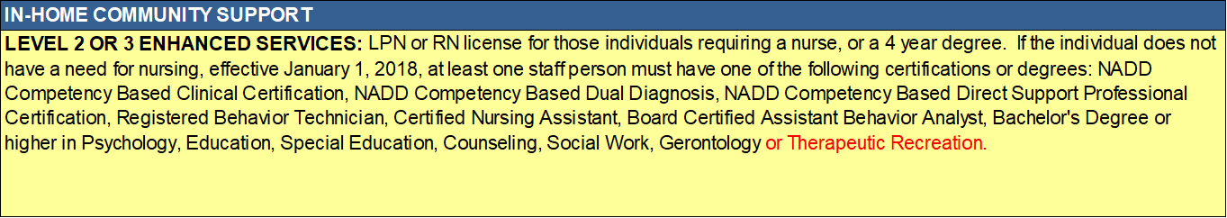
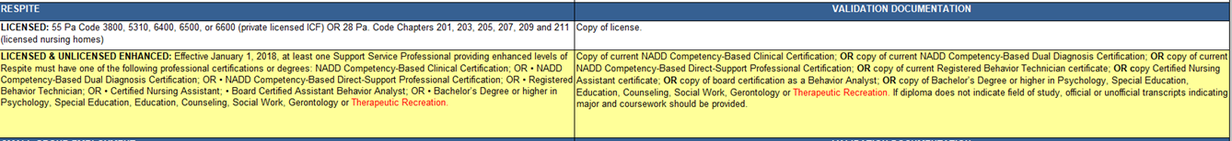
CPS, IHCS, & Respite Enhanced
Notes:
For CPS, IHCS, and Respite, under enhanced, there is additional qualification language related to Therapeutic Recreation. This change is the result of public comment recommending that Therapeutic Recreation be added as a degree that can provide enhanced levels of service for CPS, IHCS and Respite.

Slide 12
Residential Qualifications
New Provider Qualifications for providers rendering Residential Habilitation, Life Sharing or Supported Living
Agencies must meet the following standards:
1. Have a waiver service location in Pennsylvania.
2. Actively provided direct non-residential HCBS as a provider enrolled to provide ODP Waiver services for the two years prior to enrolling to provide Residential Habilitation, Life Sharing, or Supported Living and be in good standing (not subject to sanctions or enforcement actions by the Department).
3. Annually submit to ODP the most recent financial statement that has been audited by an independent Certified Public Accountant.
Notes:
The Centers for Medicare and Medicaid Services (CMS) approved a November 1, 2023, waiver amendment which requires any new provider of Residential Habilitation, Life Sharing, or Supported Living services to have: "Actively provide[d] direct non-residential ODP Waiver services for the two years prior to enrolling to provide Residential Habilitation, Life Sharing, or Supported Living and be in good standing (not subject to sanctions or enforcement actions by the Department). As a result, at the top of each Residential Service on the PQDR, the following information is listed.

Slide 13
Residential Qualifications
Agencies must have actively provided direct non-residential Home and Community-Based Services as a provider enrolled to provide ODP Waiver services for the two years prior to enrolling to provide Residential Habilitation, Life Sharing, or Supported Living and be in good standing (not subject to sanctions or enforcement actions by the Department). Annually submit to ODP the most recent financial statement that has been audited by an independent Certified Public Accountant. | To meet the standard of actively providing direct non-residential services, providers are required to render direct non-residential services to at least 10 individuals every month for a continuous period of 24 months immediately preceding a new qualification/enrollment of a residential service. In addition, the provider must have no sanctions or enforcement actions during the 24-month period. To verify the active delivery of services, the Assigned AE will review the provider’s data for the preceding two years. If there were billing issues during this time, additional documentation (such as service notes) can be submitted to substantiate that the provider meets the requirement. The AE will confirm with the rate setting mailbox that the provider has submitted the most recent financial statements.
Notes:
As a result, at the top of each Residential Service on the PQDR, the validation documentation indicates that:
To meet the standard of actively providing direct non-residential services, providers are required to render direct non-residential services to at least 10 individuals every month for a continuous period of 24 months immediately preceding a new qualification/enrollment of a residential service. In addition, the provider must have no sanctions or enforcement actions during the 24-month period. To verify the active delivery of services, the Assigned AE will review the provider’s data for the preceding two years. If there were billing issues during this time, additional documentation (such as service notes) can be submitted to substantiate that the provider meets the requirement.
In addition, the AE will confirm with the rate setting mailbox that the provider has submitted the most recent financial statements.

Slide 14
Residential and Remote Supports
Participants authorized to receive Residential Habilitation/Life Sharing/Supported Living services:
  May receive Assistive Technology Remote Supports Equipment and Technology (procedure code W6087) to purchase or lease devices or equipment or technology that will be used exclusively by the participant for the delivery of remote supports as a method of Residential Habilitation/Life Sharing/Supported Living service delivery.
  The following services may not be authorized for participants who receive Life Sharing/Residential Habilitation/Supported Living services: Homemaker/Chore; In-Home and Community Supports; Family/Caregiver Training and Support; Remote Supports; and Consultative Nutritional Services.
Notes:
ODP now allows a participants who receive remote supports as a method of residential service delivery to also receive Equipment and Technology needed for the delivery of the service through the Remote Supports service. This change will mitigate confusion currently caused by allowing the equipment and technology to be purchased through Assistive Technology and provide additional transparency regarding which participants are receiving remote supports as a method of residential service delivery.

Slide 15
Residential and Remote Supports
Residential Habilitation/Life Sharing/Supported Living services: | VALIDATION DOCUMENTATION
REMOTE SUPPORT (Residential Remote Supports Equipment and Technology) When rendering remote support services to participants, the Residential provider must have a supportive technology professional (direct, contracted, or in a consulting capacity) available who has either a current Assistive Technology Professional certificate from rehabilitation Engineering and Assistive Technology Society of North America (RESNA) or Enabling Technology Integration Specialist SHIFT certification. The agency must have a policy that outlines the responsibilities of the supportive technology professional which includes but is not limited to the following:1. Completion of evaluations of participants’ assistive technology needs, including a functional evaluation of the impact of appropriate remote supports. 2. Completion of an evaluation plan that, at a minimum, includes the need(s) of the participant that will be met by the remote supports, how the remote supports will ensure the participant's health, welfare and independence and the training needed to successfully utilize the technology and the back-up plan that will be implemented should there be a problem with the remote supports. 3.Informing the participant and anyone identified by the participant, of what impact the remote supports will have on the participant’s privacy. This information must be provided to the participant in a form of communication to be understood by the individual. This process must be completed prior to the utilization of remote supports and any time there is a change, including technology devices utilized. 4. Ensuring that the remote supports technology is in good working order. This information will be provided to the participant and service plan team for discussion and inclusion of the remote supports in the service plan." | REMOTE SUPPORT (Residential Remote Supports Equipment and Technology) Documentation of a professional (direct, contracted, or in a consulting capacity) available who has either a current Assistive Technology Professional certificate from Rehabilitation Engineering and Assistive Technology Society of North America (RESNA) or Enabling Technology Integration Specialist SHIFT certification; AND Copy of policy outlining the responsibilities of the supportive technology professional which includes but is not limited to the following: 1. Completion of evaluations of participants’ assistive technology needs, including a functional evaluation of the impact of appropriate remote supports. 2. Completion of an evaluation plan that, at a minimum, includes the need(s) of the participant that will be met by the remote supports, how the remote supports will ensure the participant's health, welfare and independence and the training needed to successfully utilize the technology and the back-up plan that will be implemented should there be a problem with the remote supports. 3.Informing the participant and anyone identified by the participant, of what impact the remote supports will have on the participant’s privacy. This information must be provided to the participant in a form of communication to be understood by the individual. This process must be completed prior to the utilization of remote supports and any time there is a change, including technology devices utilized. 4. Ensuring that the remote supports technology is in good working order. This information will be provided to the participant and service plan team for discussion and inclusion of the remote supports in the service plan.
Notes:
Participants authorized to receive Residential Habilitation/Life Sharing/Supported Living services:
•May receive Remote Supports Equipment and Technology (procedure code W6087) to purchase or lease equipment or technology that will be used exclusively by a participant for the delivery of remote supports as a method of Residential Habilitation/Life Sharing/Supported Living service delivery. The following qualification language was added to residential services for Remote Supports.
When rendering remote support services to participants, the Residential provider must have a supportive technology professional (direct, contracted, or in a consulting capacity) available who has either a current Assistive Technology Professional certificate from rehabilitation Engineering and Assistive Technology Society of North America (RESNA) or Enabling Technology Integration Specialist SHIFT certification.
The agency must have a policy that outlines the responsibilities of the supportive technology professional which includes but is not limited to the following:
1. Completion of evaluations of participants’ assistive technology needs, including a functional evaluation of the impact of appropriate remote supports. 2. Completion of an evaluation plan that, at a minimum, includes the need(s) of the participant that will be met by the remote supports, how the remote supports will ensure the participant's health, welfare and independence and the training needed to successfully utilize the technology and the back-up plan that will be implemented should there be a problem with the remote supports. 3.Informing the participant and anyone identified by the participant, of what impact the remote supports will have on the participant’s privacy. This information must be provided to the participant in a form of communication to be understood by the individual. This process must be completed prior to the utilization of remote supports and any time there is a change, including technology devices utilized. 4. Ensuring that the remote supports technology is in good working order. This information will be provided to the participant and service plan team for discussion and inclusion of the remote supports in the service plan.

Slide 16
Non-Residential Remote Supports
To provide Remote Supports services, the agency must meet the following standards regardless of provider service location:
Enroll directly with ODP to render the Remote Supports service.
Have a waiver service location in Pennsylvania or a state contiguous to Pennsylvania. (The physical location of a company that sells a good may be located anywhere in the United States or the American territories.)
Have a secure, central facility in the United States where staff render Remote Supports that has appropriate and stable connections, including redundant internet and power that ensure continuity of service in the event of a disruption or connection. This facility must be staffed 24 hours a day, 7 days a week.
Have staff available to provide in-person training as needed or requested as described in the Remote Supports Implementation Plan.

Slide 17
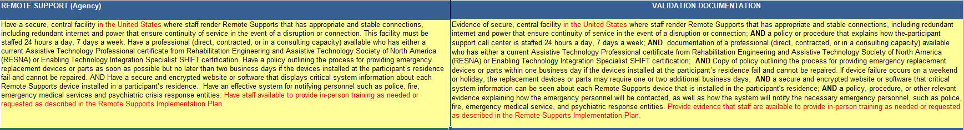
Remote Support Changes

Slide 18
Tab 14 Electronic Fingerprinting

Slide 19
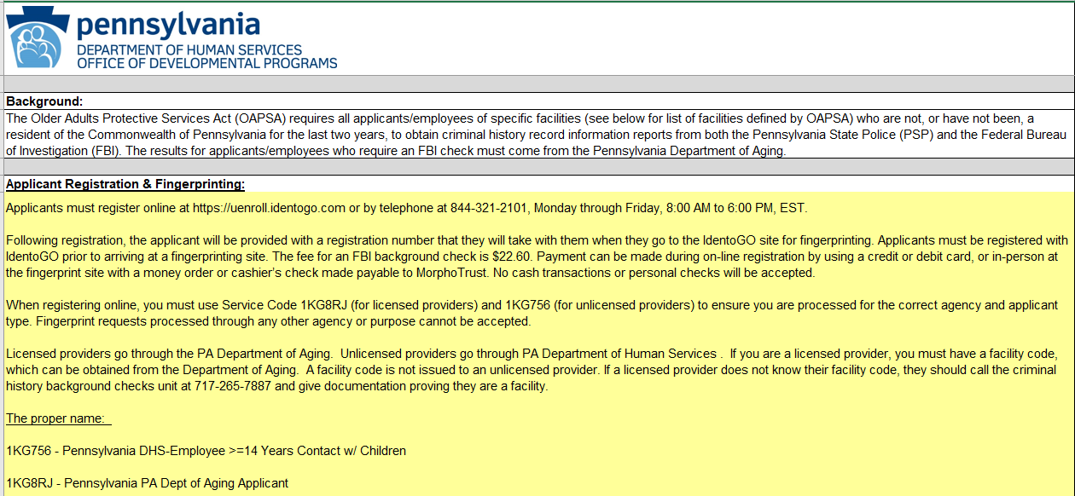
Tab 14 Electronic Fingerprinting
Notes:
Tab 14 has been updated to reflect additional clarification codes for licensed and unlicensed providers

Slide 20
Tab 15 Questions & Answers

Slide 21
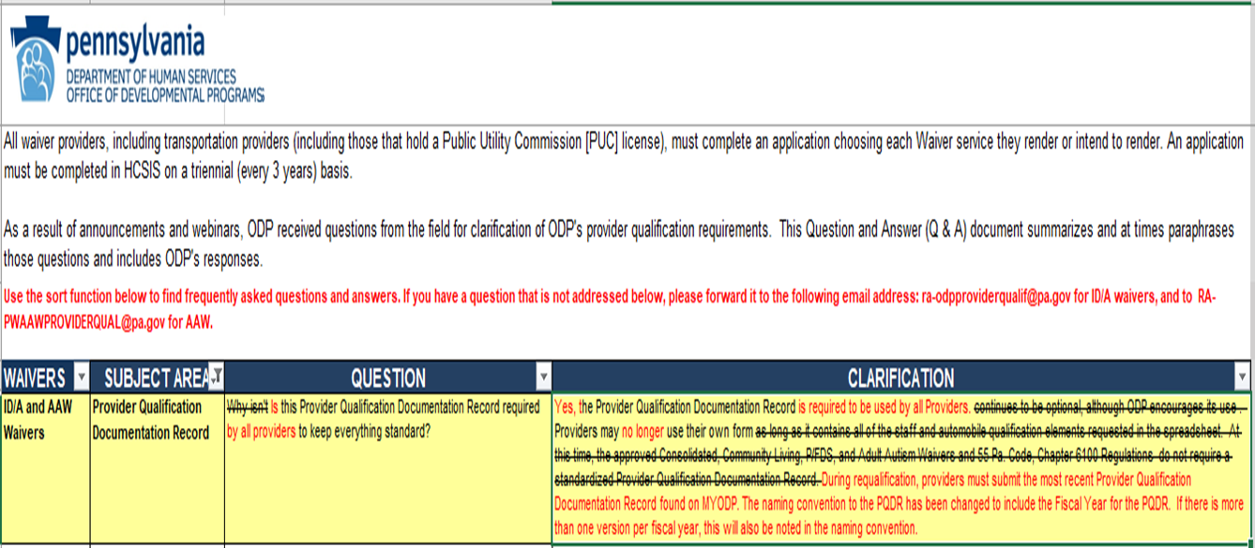
Tab 15 Q&A
During requalification, providers must submit the most recent Provider Qualification Documentation Record found on MYODP.
The naming convention to the PQDR has been changed to include the Fiscal Year for the PQDR. If there is more than one version per fiscal year, this will also be noted in the naming convention.
Notes:
Language related to optional completion has been removed to ensure statewide consistency.

Slide 22

Specialty Telehealth and Assessment Team
The Specialty Telehealth and Assessment Team service will be implemented in March 2024 and added to the PQDR.
Participants enrolled in ODP’s waivers have a high utilization of medical services including emergency rooms and hospitalization. Specialty Telehealth and Assessment Team services have proven in other states to result in reduced costs and improved health outcomes.

Slide 23

Questions?

